Slide 1
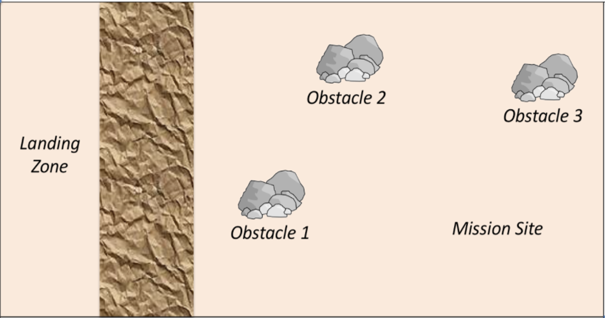
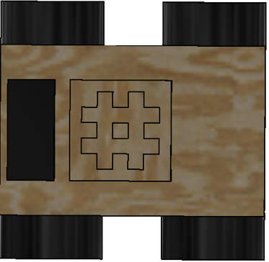



B) Move to the same altitude as mission site
E) Transmit the data
A) Send and receive position information through communication module
D) Collect data
If there are obstacle
C) Go through terrain and head toward mission site
2) Release the claw and securely grab the item
3) Collect the force used to pick up the item
1) Turn 90 degrees and move in parallel direction
2) Compare the altitude difference. Stop when it’s same
3) Turn 90 degrees back
25% time there are no obstacles – Go straight forward
Use two sensors in front to detect obstacle and correspondingly adjust the direction through motor
1) Use sensor to detect the material of the item

Slide 2
Flowchart
A) Send and receive position information through communication module
1) Turn 90 degrees and move in parallel direction
B) Move to the same altitude as mission site
2) Compare the altitude difference. Stop when it’s same
C) Go through terrain and head toward mission site
3) Turn 90 degrees back
If there are obstacle
25% time there are no obstacles – Go straight forward
Use two sensors in front to detect obstacle and correspondingly adjust the direction through motor
D) Collect data
1) Use sensor to detect the material of the item
2) Release the claw and securely grab the item
E) Transmit the data
3) Collect the force used to pick up the item

